Slide 1


Team 38: Virtual Try-On Clothing
Bi-Weekly Update 2 Robin Martinez, Alan Vela, Jorge Olivares Sponsor: Pranav Dhulipala TA: Fardeen Mozumder
Notes:
Michelle

Slide 2
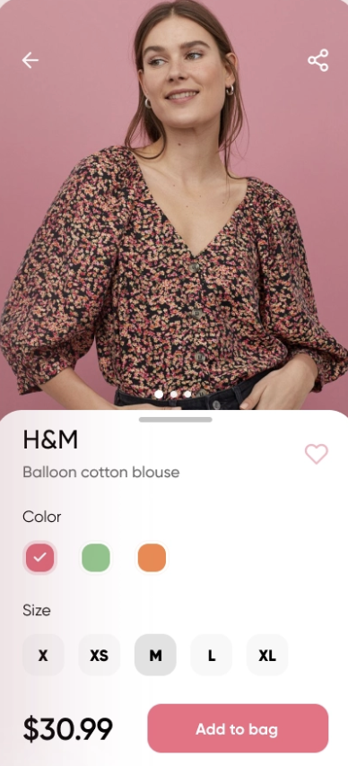
Project Summary
Waste material reduction for companies producing apparel.
Our application is going to be an accessible tool for consumers shopping online for clothing. This tool will create an avatar based on the video provided and it will be able to change between clothes.

Slide 3
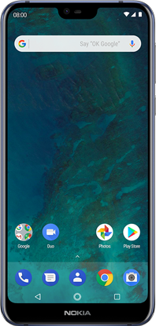
Subsystem Overview
GUI Application:
Displays the user with the application
Uploads and receives user information to a database
Database:
Stores the user’s information together with their avatar
Supply different options offered for the avatar to change clothes
Neural Network:
Receives a .mp4 video from the database
Returns a clothed 3D model of the user in .obj format
Robin | Alan | Jorge
Neural Network
GUI
App
Design
Shape Representation
Convolutional Architecture
Clothing Database
Loss Function
Optimization

Slide 4
Project Timeline
08/31 | 09/14 | 09/28 | 10/12 | 10/26 | 11/16
Setting up Olympus server | ML algorithm set up and ready to work on server | ML algorithm training the model | ML algorithm training the model | Implement ML model into application | Testing application with ML model and bug fixing.
Verify GUI and database are working | GUI properly communicating with the database | GUI able to write on database | Testing application on phone and bug fixing | Implement ML model into application | Testing application with ML model and bug fixing.

Slide 5
GUI Application
Accomplishments since last presentation 12 hrs | Ongoing progress/problems and plans until the next presentation
Fixed crashing on application GUI and Database established a connection | Add data to database Create a display page for users to see avatar

Slide 6
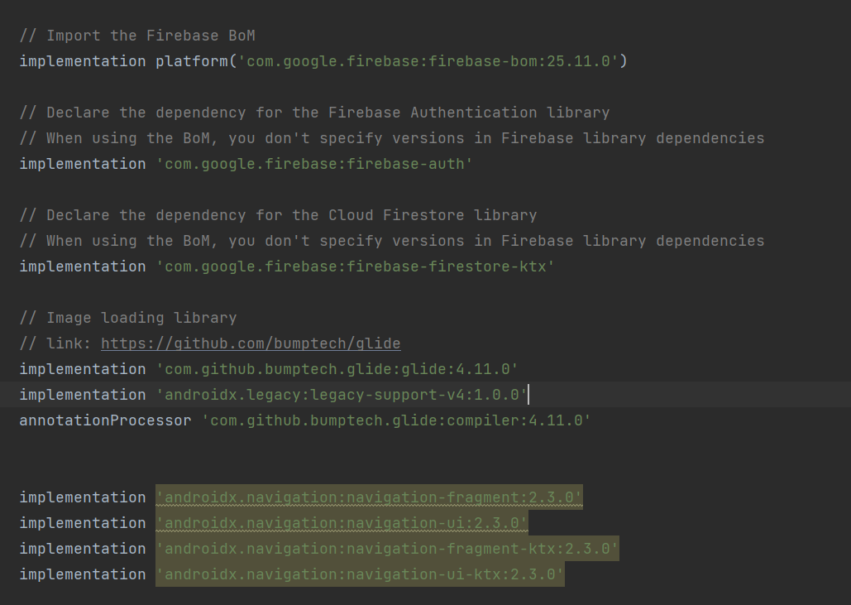
GUI Application
Remove old database
dependencies with new
one
Not many changes for
GUI more integration with
database

Slide 7
Machine Learning Model
Accomplishments since last presentation 13 hrs | Ongoing progress/problems and plans until the next presentation
Switched over to an Ubuntu OS Created a new container as olympus was reconfigured Utilized MakeHuman to attain .obj files | Replacing Dirt with another renderer Continue debugging the machine learning algorithm

Slide 8
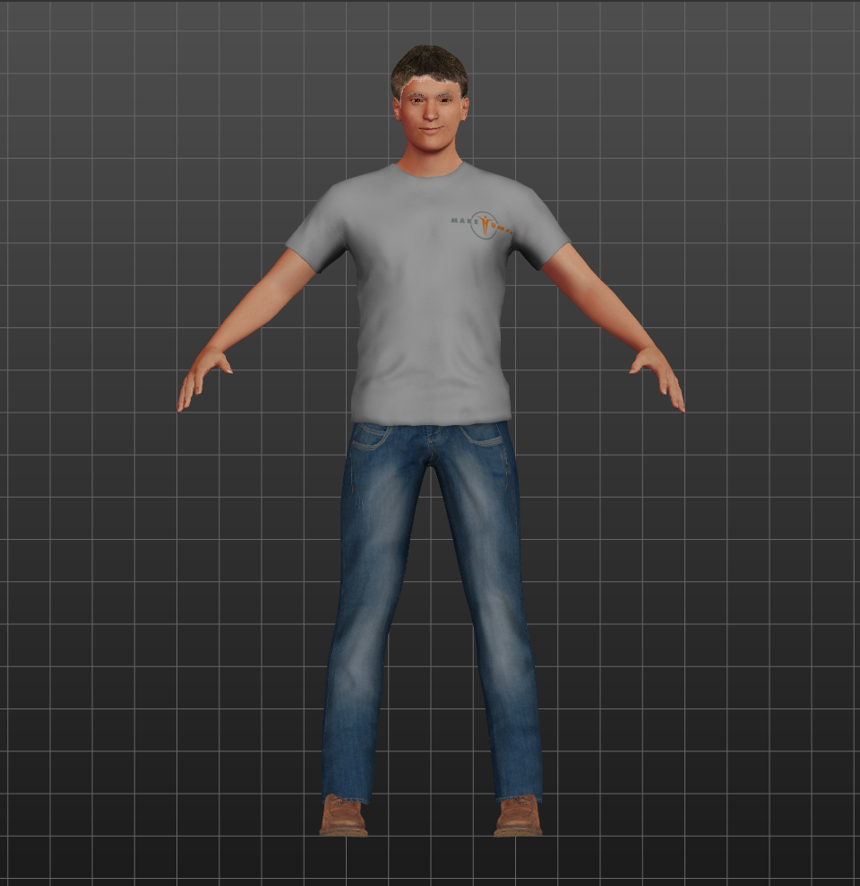
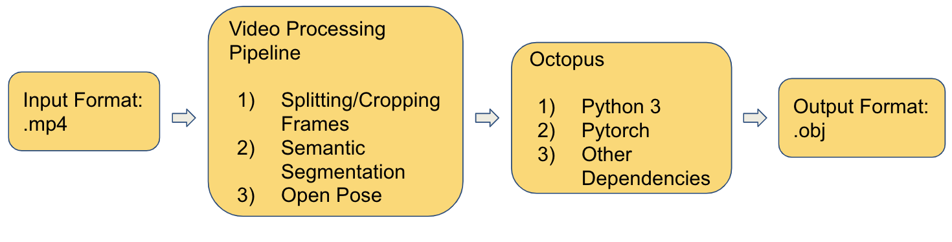
Machine Learning Model
Make Human
3D-Computer Graphics middleware
Could possibly train the model this way
Replacing Dirt
Considering Tensorflow’s renderer

Slide 9
Cloud Database
Accomplishments since last presentation 8 hrs | Ongoing progress/problems and plans until the next presentation
Created new Firebase database Establish connection between GUI and database | GUI able to write and read data to/from database

Slide 10
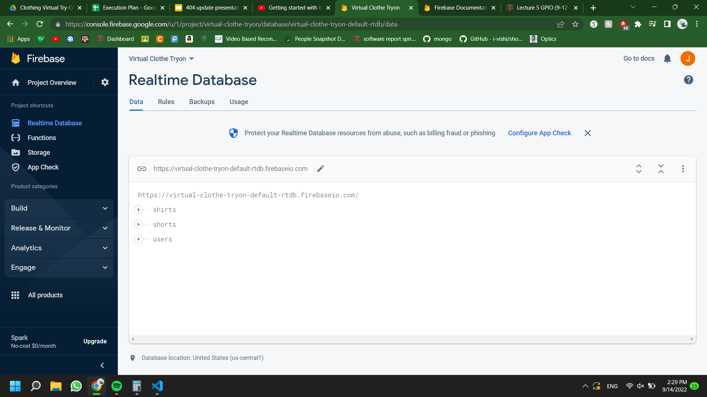
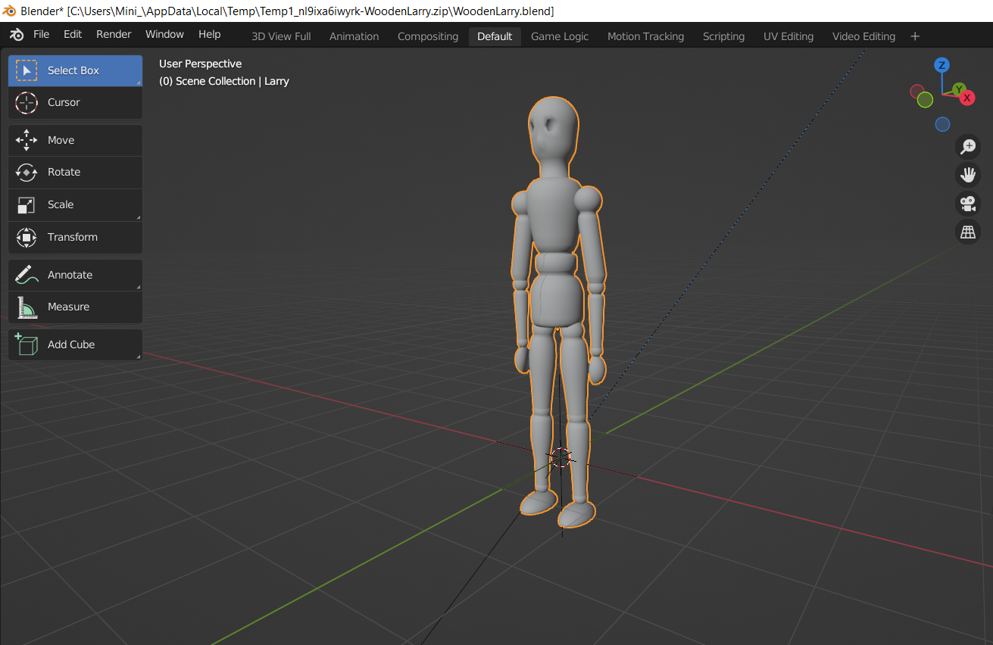
Cloud Database
Changed the database to Firebase.
Less time spent on creating a connection with the server and more working on integration.
Database receives writes string data from GUI

Slide 11
Execution Plan
 | 09/05 | 09/12 | 09/19 | 09/26 | 10/3 | 10/10 | 10/17 | 10/24 | 10/31 | 11/7
Setting access and connection to Olympus
Prepare budget and approve for parts
Get the GUI writing on database
Set up algorithm on Olympus
Purchase Posing Database
GUI reading information from database
Train Model
Create a catalog for the avatar
Display clothing catalog and dummy model
Test app on phone and bug fix
Create app package with ML model
Test app on phone with ML model and bug fix
Completed | In-progress | Not Started

Slide 12
Validation Plan
Test Name | Criteria | Owner | Status
Server ready for the ML algorithm | Access granted and connection established with the server | Robin | Tested
GUI writing to the database | User information stored in the database | Jorge,Alan | Testing
ML algorithm ready for training | Test machine learning algorithm to see the proper file is delivered (.obj) | Robin | Untested
GUI reading and displaying information | Retrieval of clothing options to the GUI and displaying a catalog | Jorge,Alan | Untested
Test app without model integration | Run the application on an actual phone and test it for possible bugs. | Jorge,Alan | Untested
Train the model | Run the machine learning algorithm through Pytorch and check outputs to view progress | Robin | Untested
Deploy trained model into application | Test the model receiving input from the application and change clothes | Group | Untested
Test application with model integration on phone | Run the application on actual phone with video input and test for possible bugs | Group | Untested

Slide 13
Questions?

